Slide 1
Faculty Feedback on a Proposed Measure of Non-Cognitive/Soft-Skills Features for Use in Graduate Schools
Jennifer L Bochenek, ETS
Brent Bridgeman, ETS

Slide 2
What is FACETS?
Non-cognitive
Noncognitive or “soft skills” are related to integrity, motivation, and interpersonal interaction and often associated with an individual’s personality, disposition, and attitudes. These will reflect in how a person behaves and reacts.
Adaptive
Selects the next item to be presented based on preceding items.
Forced Choice
Forced-choice methods require respondents to select between two equally desirable statements.
Copyright © 2019 by Educational Testing Service. All rights reserved. ETS, the ETS logo and MEASURING THE POWER OF LEARNING are registered trademarks of Educational Testing Service (ETS). 43631
Notes:
Non-Cogs aren’t just about personality, they are about skills and behaviors as well.
Adaptive means it is constantly changing
Forced Choice means that it presents two equally desirable statements

Slide 3
Key Characteristics
Customizable
Current versions exist for Workforce Sector
Can be customized to the Higher Ed sector
Resistant to Faking and Coaching
Forced-choice of pairs of statements that matching statements on their “social desirability”, so that you’re always choosing between two desirable qualities
Adaptive, with potentially up to 400,000 different items (statement pairs) in the pool, so that no two people get the same assessment
Provides Normative and Comparative data
Notes:
Customizable
- Mention that we will be looking for their feedback on how it should look in the higher ed sector at the end of this
Faking
-Lead with: “In the past, these kinds of “personal attribute” measures have not been used in admissions because they’re coachable and easy to fake, and people might have different standards for whether they agree with a statement like “I am a hard worker” (strongly agree, agree, neither, disagree, strongly disagree)”
1st statement is about the faking
2nd is related to coaching
Normative and Comparative
-Due to IRT scoring, this measure can provide comparisons of scores across test takers and referenced against norm groups. This helps interpreting the results to inform decisions

Slide 4
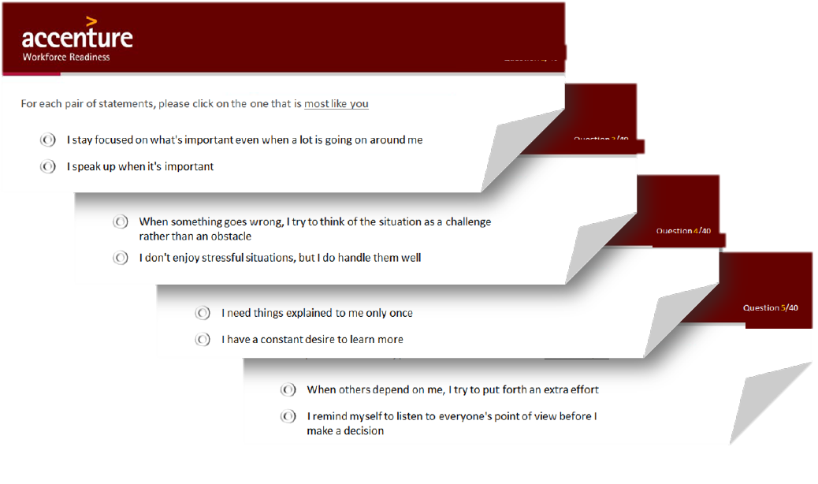
Example Items
Notes:
Previously released items in external presentations Item types
item pairs based on social desirability
Positive with Positive
Neutral with Neutral
Negative with Negative

Slide 5
Big Five Dimension | Behavioral Attribute | Brief Description
Conscientiousness | Diligence | Feelings and behaviors associated with working toward goals and other positive outcomes
 | Rule following | Personal values emphasizing tradition, duty, and traditional moral standards
 | Organization | Behaviors and intentions related to the ability to plan and organize tasks and activities
 | Dependability | Feelings and actions related to a sense of duty or being answerable for one’s behavior
 | Self-discipline | Thoughts and behaviors centered around impulsiveness, the ability to focus on tasks without distraction, and the consideration of consequences before taking action
 | Character | Beliefs and behaviors associated with adherence to standards of honesty, morality, and good Samaritan behavior
Extroversion | Assertiveness | Behaviors associated with being direct and decisive
 | Experience seeking | Intentions and behaviors associated with the exciting components of social interactions and receiving attention
 | Friendliness | Interest in engaging in friendly social interactions
Openness to experience | Aesthetic taste | Behaviors and feelings related to emotions, the senses, and art
 | Inquisitiveness | Interest and behaviors directed toward understanding how the world around us works
 | Introspectiveness | Behaviors and intentions aimed at understanding one’s self and/or facilitating self-improvement and self-actualization
 | Creativity | Thoughts and behaviors associated with imagination and original thinking
 | Intellectual orientation | Interest in and comfort with intellectual and conceptual matters
 | Open-mindedness | Thoughts and behaviors related to comfort and interest toward strangers and new stimuli
Agreeableness | Thoughtfulness/ compassion | Feelings and behaviors associated with compassion and sensitivity toward others
 | Collaboration | Behaviors and intentions centered on a desire to work or act with others for a common benefit
 | Generosity | Behaviors associated with activities such as helping and doing things for others, giving to charity, and volunteering for community improvement
Emotional stability | Stability | Feelings and behaviors associated with various degrees of insecurity and anxiety
 | Calmness | Behaviors and feelings associated with mood and strong emotions
 | Optimism | Thoughts and behaviors associated with an individual’s general emotional tone and world outlook

Slide 6
Research Questions
1.
2.
3.
Would faculty be interested in using FACETS or a FACETS-like personality measure?
How would faculty be interested in using FACETS or a FACETS-like personality measure? (e.g., for admissions, development, cohort/team selection, etc.)
What dimensions of FACETS would faculty find to be the most relevant and useful for graduate school?

Slide 7
School Characteristics
Institution | Characteristics | Faculty per Group
 |  | STEM | Social Sciences | Humanities
School 1 | Urban, Private, Moderately Selective | 2 | 2 | 3
School 2 | Urban, Private, Selective, HBCU | 5 | 3 | 3
School 3 | Suburban, Public, Moderately Selective | 3 | 3 | 2
STEM
Economics (3), Chemistry (3), Computer Science, Mechanical Engineering, Mathematics, Physics
Social Sciences
Public Affairs, International Service, History, Geography and Environmental Systems, Public Policy, Curriculum and Instruction, School Psychology, Clinical Psychology
Humanities
Audio Technology, Arts Management, Art History, Language Literacy and Culture, Intermedia and Digital Arts, Afro-American Studies, Theatre Arts, English

Slide 8
Research Question 1
Yes – 73% (19 of 26)
“Yes”, “Definitely!”, “Please”, “100%”
15% (4 of 26) were positive but mentioned restrictions such as “Yes, but only conscientiousness and openness”
No – 19% (5 of 26)
Did not see a value in adding another tool above and beyond what they already used, or don’t believe personality can be measured, etc.
Blank – 8% (2 of 26)
 | Use FACETS or Similar Assessment
Group | Yes | No | Blank
STEM (n = 10) | 90% (9) | 10% (1) | 0% (0)
Social Sciences (n = 8) | 38% (3) | 38% (3) | 25% (2)
Humanities (n = 8) | 88% (7) | 12% (1) | 0% (0)
% are within Group and n’s are in parentheses

Slide 9
Research Question 2
18 answered this open ended question
Most were interested in using it at an admission tool (14 of 18; 78%)
The second most popular use was for student development.
4 responses mentioned both admission and development purposes.
 | Count | Percent
Admission | 14 | 78%
Development | 7 | 39%
Career Services | 3 | 17%
Cohort Building | 2 | 11%
End of Program | 1 | 6%
Financial Aid | 1 | 6%
n = 18, and faculty could provide multiple use cases

Slide 10
Research Question 3
Highest Rated Dimensions:
Faculty were most interested in the dimensions under Conscientiousness and Openness to Experience
Emotional Stability was strongly desired by STEM and Humanities faculty, but not rated highly by Social Sciences
Extroversion was rated lowest by all three faculty groups
1. Diligence
2. Inquisitiveness
3. Self-Discipline
4. Intellectual Orientation
5. Dependability
6. Open-Mindedness
7. Character
8. Creativity
9. Collaboration
10. Organization

Slide 11
Research Question 3, con’t
Notes:
Arrows and numbers are cohen’s d values between the groups with the biggest gap.

Slide 12
Research Question 3, con’t
1.62
1.33
1.77
0.94

Slide 13
Conclusion
Faculty see the value of a FACETS or similar assessment for use in Graduate School
Most of the interest was for use in admissions, while use for student development or in conjunction with career services are also areas of interest
Faculty varied by group on which dimensions were most desirable, but favored those under Conscientiousness and Openness to Experience

